Slide 1


React web Development
DIGITAL LIBRARY
AST
2024

Slide 2
1
Memebers & Roles:
2
The Frontend
3
Randa Erfan:
Responsible for creating the user interface and visual design.
Reham kamal:
helped in creating the user interface and visual design
Amira abdelsalam :
Oversees the entire development of the website & Ensures the site is responsive and works across devices
4
5
6
7
The Backend
8
9
Nourhan Tamer:
Manages database and server-side logic
Yasmein Tharwat:
Ensures secure login functionality and that user data is stored safely
AST
Group :React Web Developer_SHR1_SWD2_M1e

Slide 3
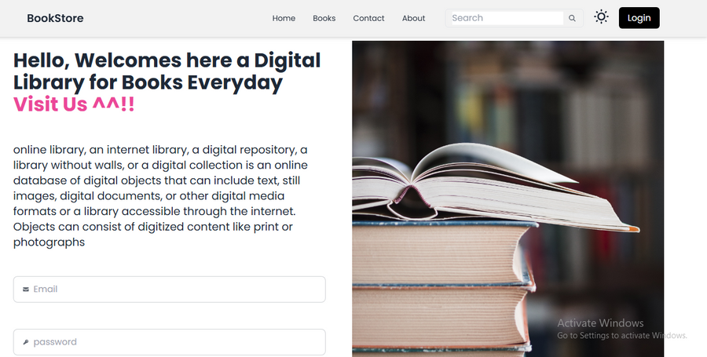
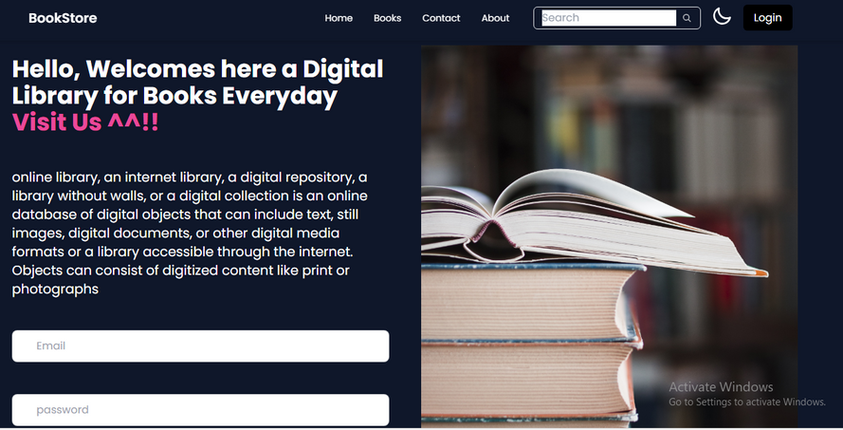
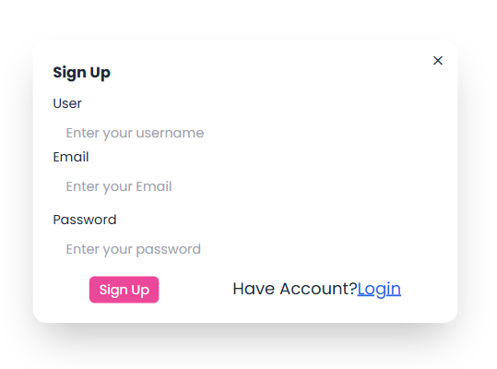
1
1
2
Digital library
2
3
Main Object:
4
easy for users to browse and find books online, will offer a user-friendly experience with features like searching also providing detailed book information
5
6
Key Features:
7
user friendly
Light/Dark Mode toggle for personalized viewing.
Clear navigation to login, signup, books, and more.
Secure login for existing users.
Quick and simple sign-up process for new users.
Books Collection:
Browse for books.
8
9

Slide 4
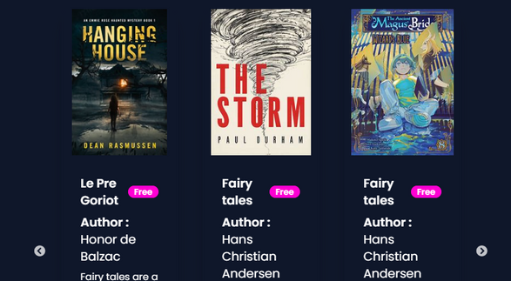
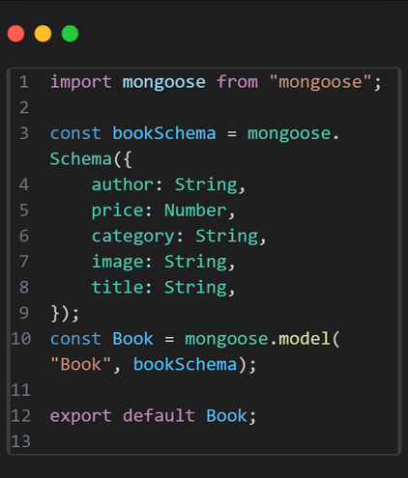
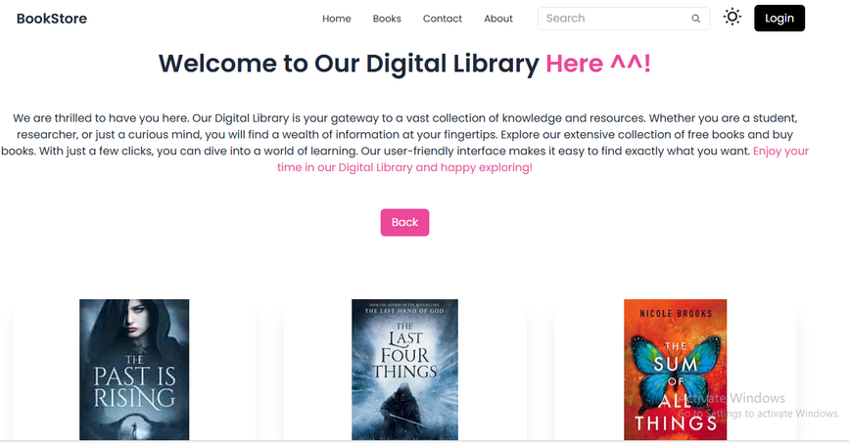
1
Home &Books
2
3
Home Page
4
Welcoming message introducing the digital library.
Light/Dark Mode toggle for personalized viewing.
Free Books Section with a Carousel displaying featured or popular free books.
Clear navigation to login, signup, books, and more.
5
6
7
Books page
8
Books Collection:
Browse for books.
9

Slide 5
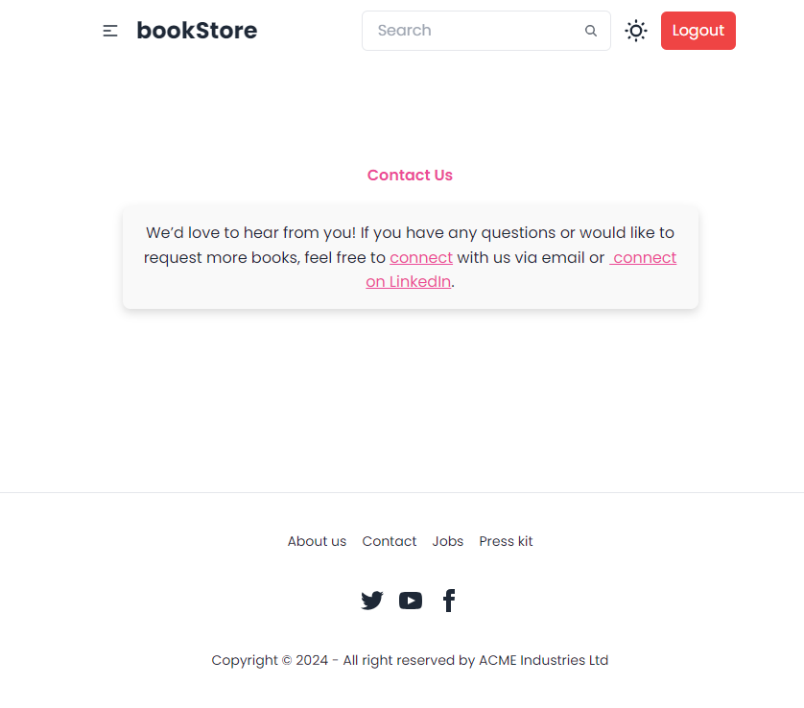
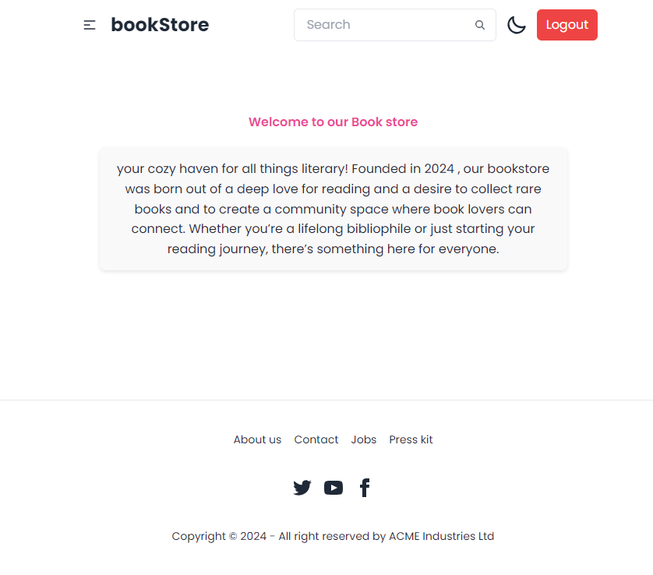
1
About & Contact
2
3
4
5
6
Provides a brief overview of the digital library’s goals and purpose.
Explains why the digital library was created, emphasizing accessibility to books and knowledge.
Allows users to get in touch with the team by submitting their name, email address, and message.
7
8
9

Slide 6
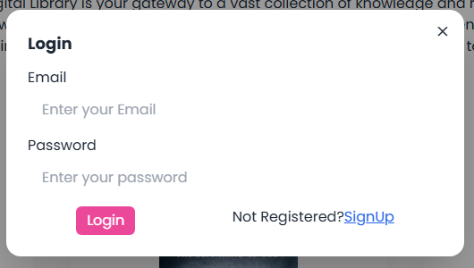
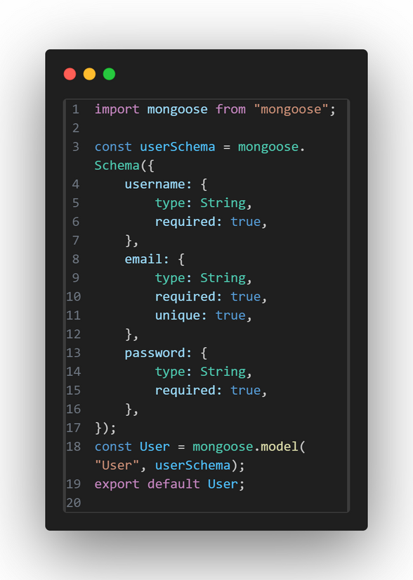
Sign up & log in
1
2
3
4
5
Login & Signup Functionality
Easy registration for new users.
Simple and secure login for existing users.
Quick and simple sign-up process for new users.
6
7
8
9

Slide 7
1
2
3
4
Thank you
5
6
7
8
9

